Slide 1
'Management of Osteoporosis associated with CKD & Renal Transplant'

Slide 2
Outline
Basics
Epidemiology
Pathophysiology And Risk Factors
Diagnosis
Management And KDIG/ Guideline Recommendations
Pharmacotherapies And Clinical Overviews
Summary

Slide 3
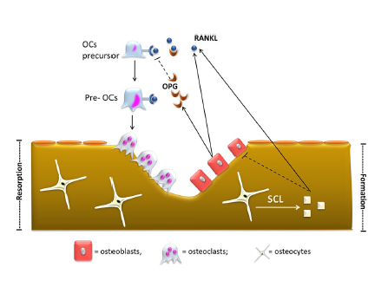
Bone Remodeling.
In physiologic condition, bone is continuously renewed through the coordinated process of bone resorption by osteoclasts and bone formation by osteoblasts
Receptor activator of NF‑κB ligand (RANKL) and osteoprotegerin (OPG), both produced by osteoblasts, are the key regulators of bone remodeling
RANK-L promotes the differentiation of osteoclasts’ precursor (OCs precursor) and pre-osteoclasts (Pre-OCs) in mature osteoclasts.
OPG, a high affinity ligand of RANK-L, acts as a soluble inhibitor of RANK-L thus reducing osteoclasts differentiation.
Osteocytes regulate bone turnover by secreting sclerostin (Scl).
Sclerostin reduces osteoblastogenesis promotes osteoblast and osteocyte apoptosis and, by inducing RANK-L synthesis, stimulates osteoclastogenesis
J Nephrol. 2017 Oct;30(5):689-699

Slide 4
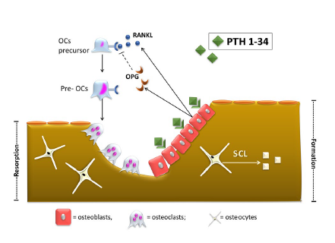
Effects of PTH 1–34 on bone.
Intermittent administration of recombinant human PTH 1–34 stimulates bone formation.
The positive effect of intermittent PTH on bone appears to be mediated through the PTH-1 receptor (PTH1R), expressed only in osteoblasts.
PTH1R activation increases osteoblasts’ number and activity.
However, osteoblasts activation by PTH increases receptor activator of NF‑κB ligand (RANK-L) synthesis and decreases osteoprotegerin (OPG) synthesis.
This, in turn, leads to new osteoclasts recruitment
and activation, thus balancing the two processes of bone formation and resorption.
However, the increment in bone formation occurs earlier
than that of bone resorption, thus increasing bone volume in the first months of therapy before osteoclast activation
J Nephrol . 2017 Oct;30(5):689-699

Slide 5
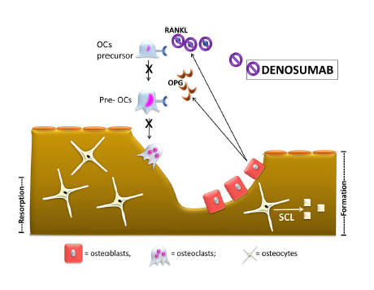
Effects of denosumab on bone.
Denosumab targets and binds receptor activator of NF‑κB ligand (RANK-L) with high affinity and specificity. RANK-L inhibition leads to suppression of osteoclasts differentiation, activity and survival.
The final effect is the reduction of bone resorption sites and increased bone volume
J Nephrol . 2017 Oct;30(5):689-699

Slide 6
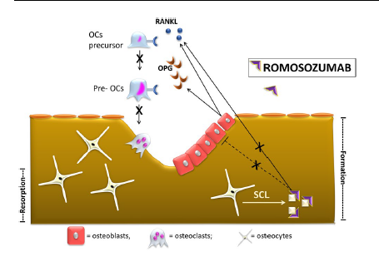
Effects of Romosozumab on bone.
Romosozumab targets and binds sclerostin (Scl). Physiologically, Scl reduces osteoblastogenesis and promotes osteoclastogenesis.
Thus, Scl inhibition leads to both anabolic (increased osteoblast activation) and anti-resorptive (reduced
osteoclastogenesis) effects
J Nephrol 2017 Oct;30(5):689-699

Slide 7
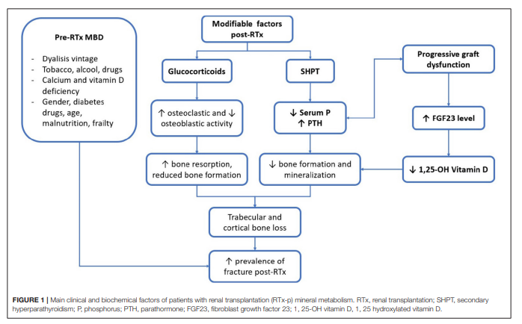
Front Med (Lausanne). 2022 Mar 10;9:821884.

Slide 8
Fragility fractures in CKD
Cohort study of 679,114 adults[1]
Women ≥ 65 years at 3 years
eGFRs of ≥ 60 ml/min per 1.73 m2: 4.3%, 45–49 ml/min per 1.73 m2: 5.8%, 30–44 ml/min per 1.73 m2: 6.5%, 15–29 ml/min per 1.73 m2: 7.8%, < 15 ml/min per 1.73 m2: 9.6%
1-year mortality rate of patients on dialysis who experience hip fracture is nearly 2-fold higher than those on dialysis who do not have a hip fracture [2,3].
Hip fracture and dialysis has 2-fold increase in mortality than those with hip fracture who do not have CKD [4,5].
1. Naylor KL, Kidney Int 86:810–818. 2. Mittalhenkle A, Am J Kidney Dis 44:672–679. 3. Am J Kidney Dis 36:1115–1121. 4 Downey C, World J Orthop 10:166–175. 5. Suh YS, J Korean Med Sci 32:2035–2041
Notes:
.

Slide 9
Post-transplantation fractures
Post-transplantation bone loss is greatest in the first 6– 12 months
Most post-transplantation fractures are peripheral.
The incidence has been variably reported but exceeds 40% in some studies (1)
In a study comparing recent renal transplant recipients to dialysis patients, the relative risk of fractures is 34% higher in the first 6-month post-transplantation (2)
Prednisolone is the main cause of bone loss during early post-transplantation (3 )
Alshayeb HM, Am. J. Kidney Dis. 2013; 61: 310–325.
Ball AM et al.. JAMA 2002; 288: 3014–3018.
Rojas E et al. Kidney Int. 2003; 63: 1915–1923.
Notes:
3. Alshayeb HM, Am. J. Kidney Dis. 2013; 61: 310–325.
4. Ball AM et al.. JAMA 2002; 288: 3014–3018.
5. Rojas E et al. Kidney Int. 2003; 63: 1915–1923.

Slide 10
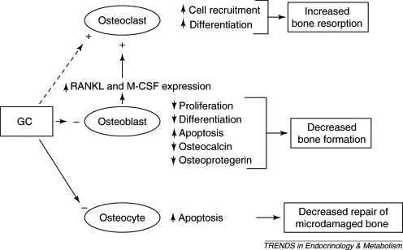
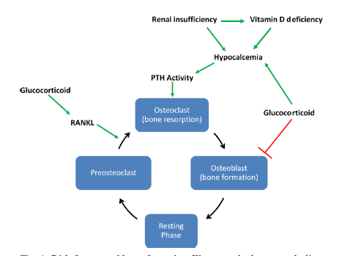
GC induced osteoporosis
Risk factors and bone formation. Illustrates the bone metabolism cycle and the relationship with risk factors for osteoporosis present in the solid organ transplant population. PTH parathyroid, RANKL receptor activator of nuclear factor-ĸB ligand; green arrows represent increased effect/activity and red represent decreased effect/activity
Osteoporos Int DOI 10.1007/s00198-015-3367-8

Slide 11
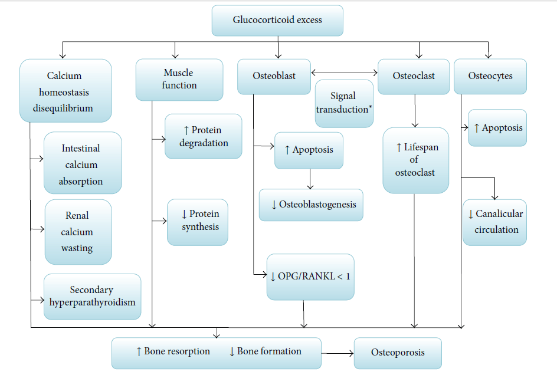
Transplantation Osteoporosis

Slide 12
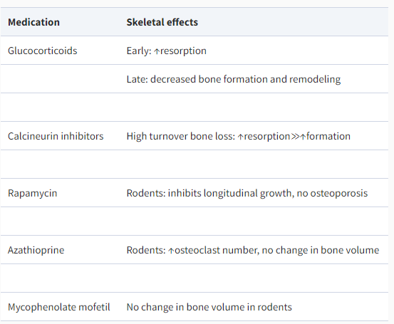
Transplantation Osteoporosis
Glucocorticoids.
In a large observational study of 77 430 RTRs who were followed for a median of 3.9 years, glucocorticoid withdrawal was associated with a 31 % reduction in fracture risk, and the incidence of fractures was higher in those patients' taking glucocorticoids when discharged.
Nikkel LE et al.. Am. J. Transplant. 2012; 12: 649–659.

Slide 13
Bone mineral density (BMD)
Valuable tool for the diagnosis of osteoporosis in post-menopausal women and older men
It cannot differentiate between osteoporosis and CKD-MBD nor other metabolic bone diseases
BMD can also overestimate bone density if patients have calcification or osteoarthritis, particularly at the lumbar spine
In a study of 485 patients on HD, BMD of the total hip predicted cases of incident and prevalent fracture [1].
KDIGO suggest that given this new evidence, BMD could be performed, particularly if it might impact the decision to perform a bone biopsy [2].
Iimori S. Nephrol Dial Transplant 27:345–351
Ketteler M. Kidney Int 92:26–36. https:// doi. org/ 10. 1016/j. kint. 2017. 04. 006

Slide 14
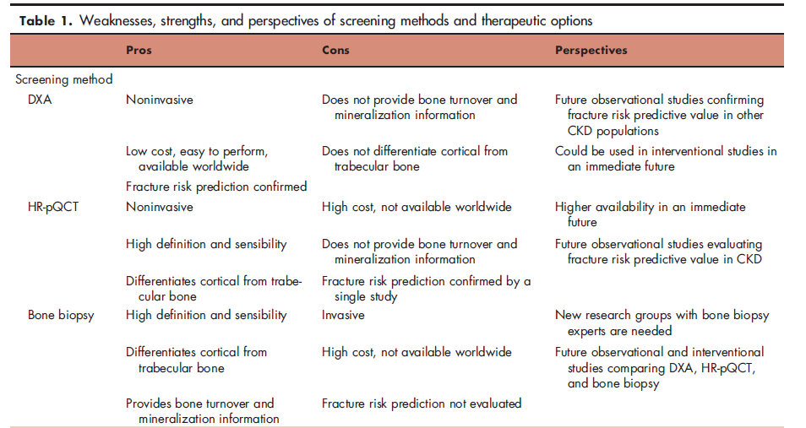
Curr Opin Nephrol Hypertens 2015, 24:317–323

Slide 15
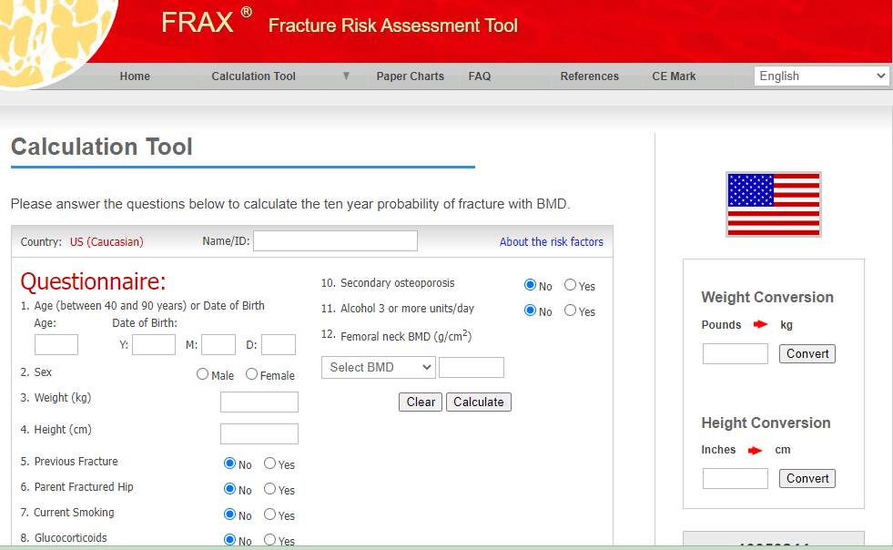
For USA use only
Consider FDA-approved medical therapies in postmenopausal women and men aged 50 years and older, based on the following:
A hip or vertebral (clinical or morphometric) fracture
T-score ≤ -2.5 at the femoral neck or spine after appropriate evaluation to exclude secondary causes
Low bone mass (T-score between -1.0 and -2.5 at the femoral neck or spine) and a 10-year probability of a hip fracture ≥ 3% or a 10-year probability of a major osteoporosis-related fracture ≥ 20% based on the US-adapted WHO algorithm
Clinicians' judgment and/or patient preferences may indicate treatment for people with 10-year fracture probabilities above or below these levels

Slide 16
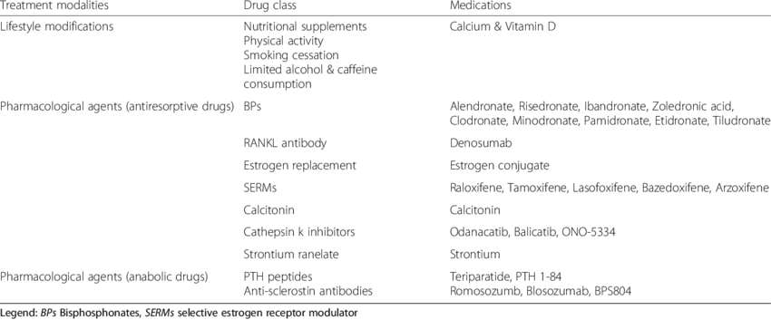
Treatment of osteoporosis

Slide 17
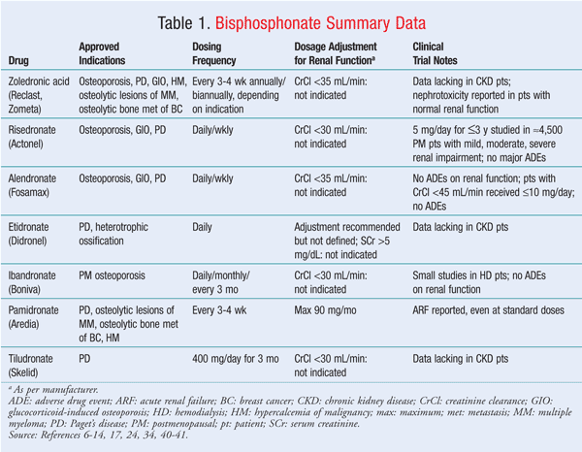
https://www.uspharmacist.com/article/bisphosphonate-nephrotoxicity-risks-and-use-in-ckd-patients

Slide 18
Comparative Chart
 | Denosumab | Bisphosphonate (Zoledronic acid ) | Romosozumab | Teriparatide
Dosage | 60 mg SQ every 6 months | 5 mg IV once yearly | 210 mg SQ monthly | 20 mcg SQ once a day
Renal impairment | Dosage adjustment not needed | Increased risk of renal toxicity Not recommended in severe renal impairment | Dosage adjustment not needed | Dosage adjustment not needed
MOA | RANKL antibody Antiresorptive | Bisphosphonate Antiresorptive | Anti-(human sclerostin) Anabolic and antiresorptive | Parathyroid Agents Anabolic
Adverse effects | Back and musculoskeletal pain , hypocalcemia | Increased risk of renal toxicity Not recommended in severe renal impairment | May increase risk of MI, stroke, and cardiovascular death. | Risk of osteosarcoma
Clinical studies | CKD : Meta analysis of 17 studies with 10214 patients , reduced fracture risk by Teriparatide (-81%), Denosumab (- 60%), Alendronate (-39%) and Raloxifene (-33%) (Front Pharmacol. 2022 Feb 11;13:822178)
Black box waring | No | No | Yes (MI and CVD) | Yes (Risk of osteosarcoma)

Slide 19
Comparative Chart
 | Denosumab | Bisphosphonate (Zoledronic acid ) | Romosozumab | Teriparatide
Hip fracture risk reduction | -44% | -40% | -56% | - | 107 trials (193,987 postmenopausal women; mean age, 66 years J Clin Endocrinol Metab, May 2019, 104(5):1623–1630
Non vertebral | -20% | -21% | -49% | -49%
Vertebral | -68% | -62% | -67% | -86%

Slide 20
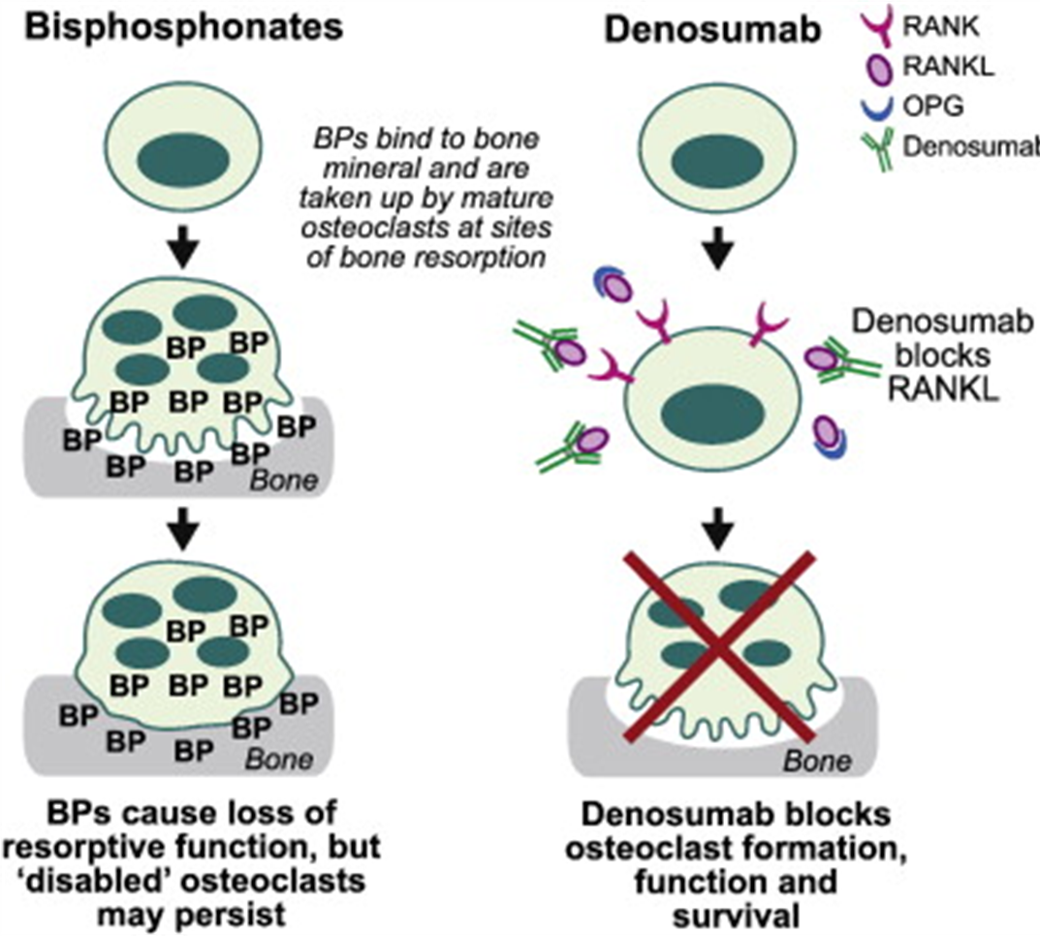
Denosumab is a more potent bone resorption inhibitor than BP.
When denosumab medication is stopped, the suppression of bone turnover is quick and completely reversed.

Slide 21
Efficacy of Osteoporosis Medications for Patients With Chronic Kidney Disease: An Updated Systematic Review and Network Meta-Analysis
Patients with CKD or a history of kidney transplantation
17 studies with data from 10,214 patients who had stage 2-5 CKD, were receiving dialysis, or had a history of kidney transplantation
Reduced risk of fractures vs placebo
Teriparatide: odds ratio (OR) = 0.19, 95% confidence interval (CI): 0.10-0.35
Denosumab: OR = 0.40, 95% CI: 0.27-0.58
Alendronate: OR = 0.61, 95% CI: 0.40-0.92
Raloxifene: OR = 0.52, 95% CI: 0.41-0.67]
Rank probability and the surface under the cumulative ranking (SUCRA) values
Teriparatide ranked the highest for improvement in vertebral bone mineral density (BMD) (SUCRA = 97.8%)
Denosumab ranked the highest for improvement in femoral neck BMD (SUCRA = 88.3%).
Chia-Hsien Chen et al., Front Pharmacol. 2022 Feb 11;13:822178

Slide 22
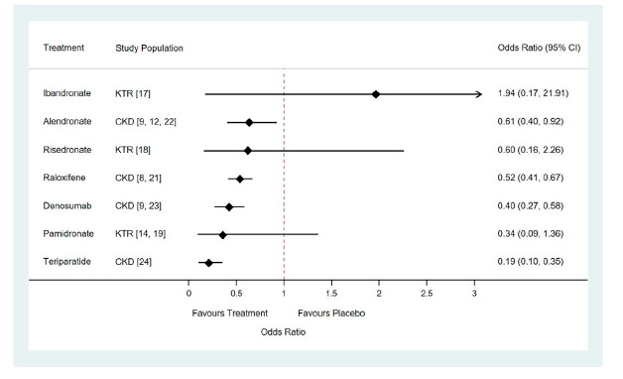
Teriparatide and denosumab seem to be the most effective treatments for preventing bone loss and reducing the risk of fracture in network comparison
Forest plots of relative risk of vertebral or clinical fractures of seven drugs for the treatment of osteoporosis compared with placebo in patients with chronic kidney disease or underwent kidney transplantation. Abbreviation: CKD, Chronic Kidney Disease; KTR, Kidney Transplant Recipients
Chia-Hsien Chen et al., Front Pharmacol. 2022 Feb 11;13:822178

Slide 23
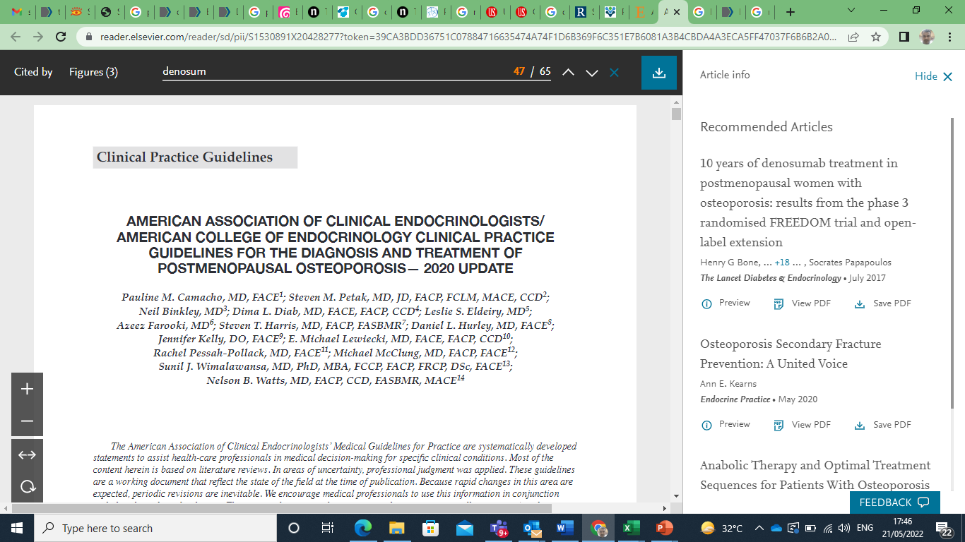
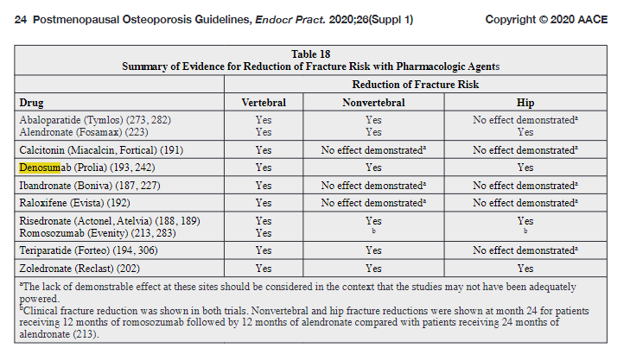

Slide 24
Prior to using antiresorptive medications in CKD… KDIGO recommendations 2017
CKD stage 1–3 disease
Recommend measuring baseline serum calcium, phosphate, PTH, alkaline phosphatase (ALP), and 25 hydroxyvitamin D (25-OHD) as a start
If values are normal , antiresorptive medications as per usual osteoporosis guidelines.
Ketteler M, Block GA, Evenepoel P et al (2017) Executive summary of the 2017 KDIGO chronic kidney disease–mineral and bone disorder (CKD-MBD) guideline update: what’s changed and why it matters. Kidney Int 92:26–36. https:// doi. org/ 10. 1016/j. kint. 2017. 04. 006
Notes:
18. Ketteler M, Block GA, Evenepoel P et al (2017) Executive summary of the 2017 KDIGO chronic kidney disease–mineral and bone disorder (CKD-MBD) guideline update: what’s changed and why it matters. Kidney Int 92:26–36. https://doi.org/10.1016/j. kint.2017.04.006

Slide 25
Prior to using antiresorptive medications in CKD… KDIGO recommendations
CKD stage 4–5 disease (i.e., eGFR < 30 ml/min/1.73 m2) and those using dialysis
Although recommendations are not guided by high-quality evidence, KDIGO suggests, that if baseline serum calcium, phosphate, PTH, and 25-OHD are abnormal, the following might be considered
Hyperphosphatemia
Mild hyperphosphatemia, one can reduce dietary phosphate
If resistant, phosphate binders can be considered
In CKD stage 5, dialytic removal of phosphate can be used
Hypocalcemia
Serum calcium should be maintained within the reference range, which is typically 2.15–2.60 mmol/L corrected for serum albumin.
For those using dialysis, dialysate calcium concentrations of 2.5–3.0mEq/L can also be used
Vitamin D
Hyperparathyroidism
If PTH remains out of target despite correction of hypocalcemia, hyperphosphatemia, and use of vitamin D analogs, calcimimetics followed by parathyroidectomy might be considered
Ketteler M, Block GA, Evenepoel P et al (2017) Executive summary of the 2017 KDIGO chronic kidney disease–mineral and bone disorder (CKD-MBD) guideline update: what’s changed and why it matters. Kidney Int 92:26–36. https:// doi. org/ 10. 1016/j. kint. 2017. 04. 006
Notes:
18. Ketteler M, Block GA, Evenepoel P et al (2017) Executive summary of the 2017 KDIGO chronic kidney disease–mineral and bone disorder (CKD-MBD) guideline update: what’s changed and why it matters. Kidney Int 92:26–36. https://doi.org/10.1016/j. kint.2017.04.006

Slide 26
Prior to using antiresorptive medications in CKD ….Bone biopsy and adynamic bone disease
Gold standard for diagnosis of underlying CKD-MBD
Suggested particularly in those with CKD stage 3a–5D
2017 update to the KDIGO guidelines emphasize that antiresorptive therapy should not be withheld for bone biopsy.
This is because bone biopsy is invasive, expensive, and often not available in clinical practice.
Important subtype of CKD-MBD to rule out before considering antiresorptive medications is adynamic bone disease
In the absence of bone biopsy, a low normal PTH, ALP, and bone-specific (bs) ALP is suggestive of adynamic bone disease in those using dialysis
Hemodialysis (HD) patients (in whom adynamic bone disease is particularly prevalent), bs- ALP < 20 μg/L (0.02 U/L) and PTH < 200 ng/L (21 pmol/L) had 100% sensitivity, 100% specificity, 100% PPV, and 84% NPV for adynamic bone disease [25].
Archives of Osteoporosis (2021) 16:116

Slide 27
Prior to using antiresorptive medications in CKD ….Bone biopsy and adynamic bone disease
The use of antiresorptive medications in adynamic bone disease might worsen bone health [26].
Amerling R, Blood Purif 29:293–299. https:// doi. org/ 10. 1159/ 00027 6666

Slide 28
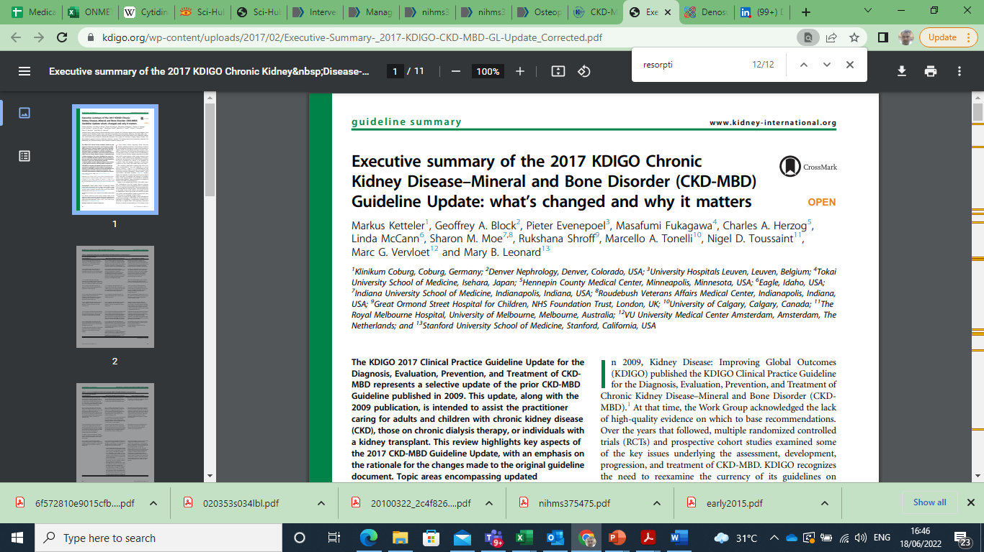
Treatment of bone with bisphosphonate
4.3.1: In patients with CKD G1–G2 with osteoporosis and/or high risk of fracture, as identified by World Health Organization criteria, we recommend management as for the general population (1A).
4.3.2: In patients with CKD G3a–G3b with PTH in the normal range and osteoporosis and/or high risk of fracture, as identified by World Health Organization criteria, we suggest treatment as for the general population (2B).

Slide 29
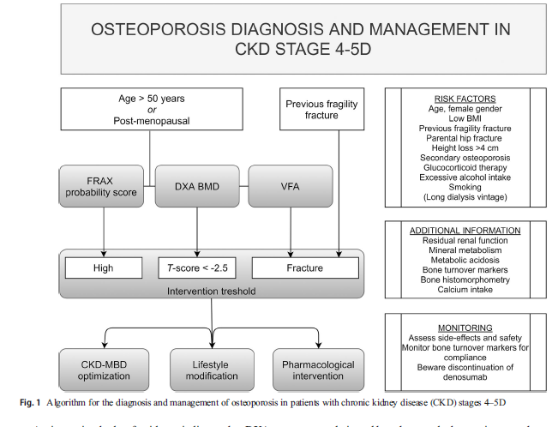
Osteoporos Int. 2021 Dec;32(12):2397-2405.

Slide 30
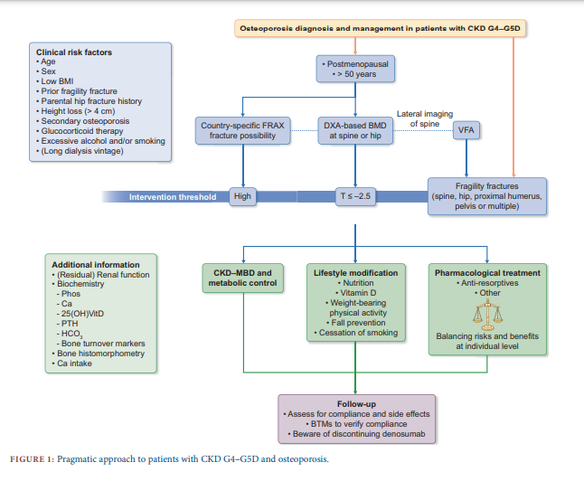
Nephrol Dial Transplant . 2021 Jan 1;36(1):42-59.

Slide 31
Evaluation and treatment of kidney transplant bone disease
5.1: In patients in the immediate post–kidney transplant period, we recommend measuring serum calcium and phosphate at least weekly, until stable (1B).
Reasonable monitoring intervals would be:
In CKD G1T–G3bT, for serum calcium and phosphate, every 6–12 months; and for PTH, once, with subsequent intervals depending on baseline level and CKD progression.
In CKD G4T, for serum calcium and phosphate, every 3–6 months; and for PTH, every 6–12 months.
In CKD G5T, for serum calcium and phosphate, every 1–3 months; and for PTH, every 3–6 months.
In CKD patients receiving treatments for CKDMBD, or in whom biochemical abnormalities are identified, it is reasonable to increase the frequency of measurements to monitor for efficacy and side effects (Not Graded).
It is reasonable to manage these abnormalities as for patients with CKD G3a–G5 (Not Graded).
5.6: In patients in the first 12 months after kidney transplant with an estimated glomerular filtration rate greater than approximately 30 ml/min/ 1.73 m2 and low BMD, we suggest that treatment with vitamin D, calcitriol/alfacalcidol, and/or antiresorptive agents be considered (2D)
Insufficient data to guide on treatment after 12 months .

Slide 32
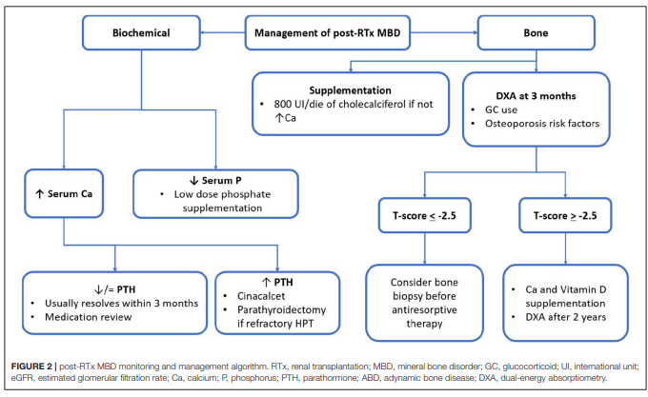
Front Med (Lausanne). 2022 Mar 10;9:821884.

Slide 33
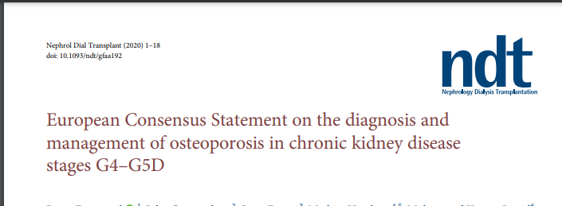

Slide 34
Diagnosis of osteoporosis in chronic kidney disease
1. Osteoporosis is a condition characterized by low bone mass and microarchitectural and qualitative bone deterioration that leads to bone fragility and fracture susceptibility.
2. The operational definition of osteoporosis is based on an areal bone mineral density (BMD) assessed by dual-energy X-ray absorptiometry (DXA) at the spine or hip

Slide 35
Risk factors for fragility fractures
1. Clinical risk factors for osteoporosis in chronic kidney disease (CKD) patients comprise traditional risk factors including older age, female sex, low body mass index, fragility fracture history, glucocorticoid treatment and CKD-specific risk factors such as long dialysis duration.
2. BMD as assessed by DXA predicts fractures in patients with CKD G4–G5D. However, DXA probably underestimates the actual fracture risk in patients with CKD G4– G5D, as it does not account for impaired bone quality. The consistency of the risk prediction across stages of disease and degree of parathyroid hormone (PTH) control remains to be documented.

Slide 36
Assessment of fracture risk
1. In patients with CKD G4–G5D, DXA may be considered in postmenopausal women, or men >50 years of age. Routine DXA testing (screening) in all CKD G4–G5D patients is not supported by current evidence.
2. The hip and the lumbar spine are the primary skeletal site to evaluate BMD by DXA.
3. The forearm may be included in the DXA evaluation of the skeletal site panel, but one should be aware of operator-dependent variability and potential bias by arteriovenous fistula.
4. Trabecular bone score and alternative imaging techniques need further clinical evaluation pending clinical implementation.
5. Vertebral fracture assessment (VFA) and/or lateral spine imaging is recommended in all patients undergoing DXA evaluation and in patients with a history of 4 cm height loss, kyphosis, or recent or current long-term oral glucocorticoid therapy. Imaging should include the abdominal aorta for determination of vascular calcification.
6. FRAX predicts fracture probability in all CKD stages. Additional evidence is required to define whether further arithmetic adjustments to conventional FRAX estimates have to be made with knowledge of advanced CKD.
7. Non-kidney-retained bone turnover markers (BTMs), especially bone-specific alkaline phosphatase, may be useful for fracture risk prediction in CKD G4–G5D, awaiting further confirmation.

Slide 37
Intervention thresholds for pharmacological therapy
1. CKD patients >50 years of age with a prior fragility fracture [(major osteoporotic fracture (MOF)] may be considered for treatment without the need for further BMD assessment.
2. In the absence of MOF, a DXA T-score threshold 2.5 at the lumbar spine or hip is recommended, recognizing that a higher threshold of 2.0 or 1.5 may be more appropriate.
3. FRAX country-specific intervention thresholds are appropriate in CKD patients.

Slide 38
Non-pharmacological intervention
1. A sufficient supply of calcium should be guaranteed (800– 1200 mg/day, preferentially through diet) and vitamin D stores should be repleted according to osteoporosis and CKD-MBD guidelines.
2. Regular weight-bearing exercise should be advised, tailored to the needs and abilities of the individual patient.
3. The falls risk needs to be evaluated regularly and acted upon.

Slide 39
Pharmacological intervention
1. CKD-MBD therapy should be optimized according to current guidelines before considering specific osteoporosis management.
2. Metabolic disturbances linked to bone fragility (acid–base, uraemic toxicity) should be controlled at all times.
3. Risks and benefits of available pharmacological interventions need to be balanced at the individual level and discussed with the patient. Formal informed consent may be required when considering off-label use.
4. Evolving evidence indicates that antiresorptive agents may be effective in advanced CKD and that vascular and skeletal risks are not excessively high.
5. Renal risks of bisphosphonates are poorly explored in patients with CKD G4–G5D, which calls for caution.
6. Denosumab confers no risk of kidney function decline, but the risk of severe hypocalcaemia with denosumab is increased in CKD and needs to be addressed by concomitant vitamin D and calcium supplementation.
7. Withdrawal of denosumab therapy may be associated with an increased risk of vertebral fracture.

Slide 40
Monitoring
1. Non-kidney-retained BTMs, such as bone-specific alkaline phosphatase, intact procollagen type I N-propeptide and tartrate-resistant acid phosphatase 5b, should be preferentially monitored in CKD patients.
2. Monitoring of BTMs may inform on the early therapeutic response.
3. Monitoring of BTMs after therapy withdrawal (offset of effect) may inform on the need for reintroduction.
4. Repeat DXA informs on the long-term treatment effect on BMD. The time interval when treatment effect can be detected may vary depending on the treatment modality and underlying type of renal osteodystrophy.

Slide 41
Denosumab
RANKL antibody

Slide 42
US FDA approved Indication # 1 Treatment of postmenopausal women with osteoporosis at high risk for fracture
US FDA | 2020 AACE/ACC* Post menopausal osteoporosis diagnostic criteria | Risk factors by 2020 AACE | Clinical study (FREEDOM Trial 10 yrs extension data)**
Postmenopausal women with osteoporosis | T-score −2.5 or below in the lumbar spine, femoral neck, total proximal femur, or 1/3 radius | Prior fracture without major trauma (other than fingers, toes, skull) after age 50 years | Postmenopausal women aged 60–90 years old
At high risk for fracture, defined as history of osteoporotic fracture, or multiple risk factors for fracture | T-score between −1.0 and −2.5 and a fragility fracture of proximal humerus, pelvis, or distal forearm | Clinical risk factors for osteoporosis Age ≥65 years Low body weight Smoking Early menopause Excessive alcohol intake | With lumbar spine or total hip BMD T-score of less than −2·5 at either location but greater than –4·0 at both locations
or patients who have failed or are intolerant to other available osteoporosis therapy | Low-trauma spine or hip fracture (regardless of bone mineral density | Prior spine fractures Glucocorticoid therapy equivalent to ≥5 mg of prednisone per day for 3months or more Secondary osteoporosis Height loss of kyphosis Risk factors for falling With radiographic osteopenia
*American Association of Clinical Endocrinologists/American College of Endocrinology Clinical ** Lancet Diabetes Endocrinol .2017 Jul;5(7):513-523

Slide 43
US FDA approved Indication # 2 Treatment To Increase Bone Mass In Men With Osteoporosis
US FDA | Endocrine Society Clinical Practice Guideline 2012 | Clinical data (ADAMO trial) *
Men with osteoporosis | Hip or vertebral fracture without major trauma | BMD T-score (based on male reference ranges) less than or equal to 2.0 and more than or equal to 3.5 at the LS or FN
History of osteoporotic fracture | Men who are receiving long-term glucocorticoid therapy in pharmacological doses (e.g., prednisone or equivalent 7.5 mg/d) | or had a previous major osteoporotic fracture and a BMD T-score less than or equal to 1.0 and more than or equal to 3.5 at the LS or FN
Multiple risk factors for fracture | Endocrine Society Clinical Practice Guideline 2012 | And had at least two lumbar vertebrae, one femur, and one forearm evaluable by dual-energy x-ray absorptiometry (DXA).
*J Clin Endocrinol Metab. 2012;97(9):3161–9

Slide 44
US FDA approved Indication # 3 Treatment Of Glucocorticoid-Induced Osteoporosis
US FDA | Clinical data *
Treatment of glucocorticoid-induced osteoporosis in men and women | ≥7.5 mg daily prednisone
At high risk of fracture who are either initiating or continuing systemic glucocorticoids in a daily dosage equivalent to 7.5 mg or greater of prednisone and expected to remain on glucocorticoids for at least 6 months | History of osteoporotic fracture Glucocorticoid-continuing patients ≥50 years old had T scores of -2.0 or less (or -1.0 or less with fracture history)
* Arthritis Rheumatol. 2019 Jul;71(7):1174-1184.

Slide 45
US FDA approved Indication # 4 Treatment Of Bone Loss In Men Receiving Androgen Deprivation Therapy For Prostate Cancer
US FDA | Clinical data *
Treatment to increase bone mass in men at high risk for fracture receiving androgen deprivation therapy for nonmetastatic prostate cancer | Histologically confirmed prostate cancer
 | Receiving androgen-deprivation therapy (bilateral orchiectomy or GnRH-agonist therapy) with an expected duration of such treatment for 12 or more months
 | Low bone mineral density (T score at the lumbar spine, total hip, or femoral neck of less than −1.0) at baseline or a history of an osteoporotic fracture
 | Eastern Cooperative Oncology Group performance status score of 2 or less.
* N Engl J Med. 2009 Aug 20; 361(8): 745–755.

Slide 46
US FDA approved Indication # 5 Treatment Of Bone Loss In Women Receiving Adjuvant Aromatase Inhibitor Therapy For Breast Cancer
US FDA | NCCN | Clinical data *
Treatment to increase bone mass in women at high risk for fracture receiving adjuvant aromatase inhibitor therapy for breast cancer | Consider adjuvant bisphosphonate therapy or denosumab in postmenopausal (natural or induced) patients receiving adjuvant aromatase inhibitor therapy | Early-stage histologically or cytologically confirmed breast cancer
 |  | Hormone receptor–positive and undergoing adjuvant aromatase inhibitor therapy required to have serum 25-hydroxyvitamin D levels 12 ng/mL
 |  | Completed treatment with surgery and/or radiation and chemotherapy 4 weeks before study entry.
 |  | Low bone mass (lumbar spine, total hip [total proximal femur], or femoral neck BMD corresponding to a T-score of-1.0 to -2.5).
 |  | Serum 25-hydroxyvitamin D levels ≥12 ng/mL
* J Clin Oncol 26:4875-4882

Slide 47
Clinical use # 5 Denosumab in osteoporosis/ osteopenia associated with Kidney Transplant Patients
Patient characteristics
 | Bonani et al. | Doddoli et al. | Yoshino et al. and Nakayama et al. | Brunova et al
Age (years) | 50 | 60.5 | 51 | NA
Calcium level | 2.31 ± 0.16 mmol/L | 2.33 mmol/L | NA | 2.4 ± 0.1 mmol/L
Phosphate | 0.58 ± 0.23 mmol/L | NA | NA | NA
PTH | 163.1 ± 157.9 ng/L | 95 ng/L | NA | 14.8 ± 8.9 pmol/L
L-spine BMD (g/cm2 ) | 1.002 ± 0.139 | NA | 0.95 ± 0.15 | NA
L-spine T score | − 0.67 ± 1.25 | NA | − 2.04 | − 2.9 ± 0.7
Hip/femoral neck BMD (g/cm2 ) | 0.925 ± 0.132 | 0.676 | 0.64 ± 0.11 | N/A
Hip/femoral neck T score | 0.59 ± 0.97 | − 2.7 | NA | − 2.4 ± 1.1
Immunosuppression | Cyclosporine/tacrolimus, mycophenolate, steroid | Steroid (≥ 5 mg/day). Not specified other immunosuppression | Not specified | Cyclosporine/tacrolimus, mycophenolate, sirolimus, steroid
Denosumab | 60 mg subcutaneous at baseline and at 6 month | 60 mg subcutaneous | 60 mg subcutaneous two times during the first year after transplant | 60 subcutaneous every 6 months; minimum treatment duration 1 years
Supplements | Calcium (1000 mg/day), vitamin D (≥ 800 IU/day) | Calcium and vitamin D | Alfacalcidol (0.25–1.0 mg/day) or cholecalciferol (400 IU/day) | Calcium (500–1000 mg/day), vitamin D (800–1000 IU/day) and 1,25(OH)2 vitamin D3 (calcitriol or paricalcitol 0.25–0.50 μg/day)
Doddoli S, Ann Rheum Dis 76:706 25. . Yoshino Y, JOURNAL OF BONE AND MINERAL RESEARCH; WILEY 111 RIVER ST, HOBOKEN 07030–5774, NJ USA .
Brunova J, Front Endocrinol (Lausanne) 9:162 28. .Bonani M, Am J Transplant Off J Am Soc Transplant Am Soc Transplant Surg 16(6): 1882–1891

Slide 48
Clinical use # 5 Denosumab in osteoporosis/ osteopenia associated with CKD
Stage 2-5 CKD
Receiving dialysis
History of kidney transplantation
17 studies with data from 10,214 patients who had stage 2-5 CKD, were receiving dialysis, or had a history of kidney transplantation
Denosumab significantly reduced risk of fracture by -60%
Denosumab ranked highest for improvement of femoral neck BMD
Front Pharmacol. 2022 Feb 11; 13:822178

Slide 49
Clinical use # 5 Denosumab in osteoporosis/ osteopenia associated with Kidney Transplant Patients
- Meta-analysis of 5 studies with a total of 162 kidney transplant patients
- Denosumab significantly increases in BMD with standardized mean differences (SMDs) of 3.26 (95% CI 0.88-5.64) and 1.83 (95% CI 0.43 to 3.22) for lumbar spine and femoral neck, respectively.
- Denosumab also significantly increases T scores with SMDs of 0.92 (95% CI 0.58 to 1.25) and 1.14 (95% CI 0.17 to 2.10) for lumbar spine and femoral neck, respectively
- Among kidney transplant patients with good allograft function, denosumab effectively increases BMD and T scores in the lumbar spine and femur neck
Arch Osteoporos. 2019 Mar 9;14(1):35

Slide 50
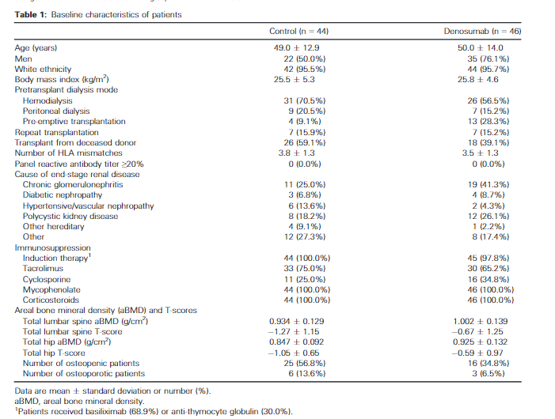
Effect of Twice-Yearly Denosumab on Prevention of Bone Mineral Density Loss in De Novo Kidney Transplant Recipients: A Randomized Controlled Trial
Inclusion Criteria
Adult male and female end-stage renal disease
Transplanted up to 28 days previously with a kidney allograft and being treated with standard triple immunosuppression including a calcineurin antagonist, mycophenolate, and corticosteroids.
Exclusion criteria
Poor or unstable graft function (creatinine>200mmol/L)
Severe osteoporosis (T-score below 4.0),
severe hyper- or hypoparathyroidism (iPTH>800 or<10 ng/L)
Hypo- or hypercalcemia (total calcium<1.8 or >2.7 mmol/L).
All patients were prescribed daily supplements of calcium (1000 mg), and vitamin D (800 IU or more).
American Journal of Transplantation 2016; 16: 1882–1891

Slide 51
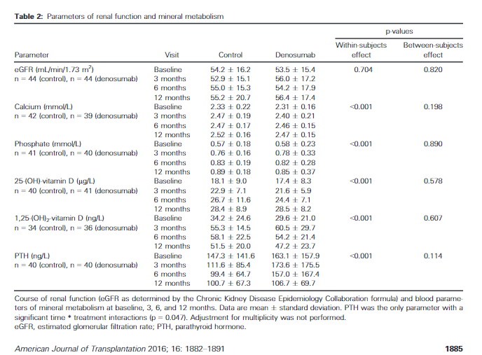
Effect of Twice-Yearly Denosumab on Prevention of Bone Mineral Density Loss in De Novo Kidney Transplant Recipients: A Randomized Controlled Trial
Episodes of cystitis and asymptomatic hypocalcemia occurred more often with denosumab, where as graft function, rate of rejections, and incidence of opportunistic infections were similar.
In conclusion, denosumab increased BMD in the first year after kidney transplantation but was associated with more frequent episodes of urinary tract infection
American Journal of Transplantation 2016; 16: 1882–1891

Slide 52
Safety of denosumab in a monocentric cohort of kidney transplant recipients
No unexpected adverse event [AE] or severe adverse event
No graft failure and no deaths.
No patient experienced fracture.
Renal function remained stable
Serum calcium was stable, no hypocalcaemia was observed.
Among patients with normal baseline PTH, two presented hyperparathyroidism during the follow-up period.
Among the 11 patients with baseline hyperparathyroidism, 7 had an increased PTH level between baseline and 12 months.
None were initiated on cinacalcet.
37 kidney transplant recipients on Prednisolone ≥5 mg/d.
Male: 41%, Age: 60.5 years, BMI: 24,1
Transplantation duration: 7.1 years
Osteopenic patients: 36%
Osteoporosis patients: 64%,
Total lumbar spine T-score: -2.04 SD
Total hip T-score: -2.7 SD
T-score femoral neck: 0.676 g/cm2
Serum creatinine: 132.8 mmol/L
Calcium: 2.33 mmol/L
1–25 [OH] vitamin D: 93.5 nmol/L
PTH 95: ng/l.
All patients were prescribed vitamin D and calcium supplementation.
Doddoli S, Ann Rheum Dis 76:706

Slide 53
Efficacy and Safety of Denosumab on Osteoporosis in Kidney Transplant Recipients
69 KTRs
Denosumab used within 1 yr of transplant
Significant increased in BMD
Urinary tract infection (UTI) was 17.4%, but there was no significant hypocalcemia
Denosumab in KTRs is effective and safe for the treatment of osteoporosis, but it should be carefully monitored for UTI.
5. Yoshino Y, JOURNAL OF BONE AND MINERAL RESEARCH; WILEY 111 RIVER ST, HOBOKEN 07030–5774, NJ USA

Slide 54
Clinical use # 6 Denosumab in osteoporosis/ osteopenia associated with Hemodialysis
 | Study 1 | Study 2
Age (years) | 71.3 ± 10.5 | 67.6±11.2
Duration of hemodialysis (years) | 9.0 (2.4–13.2) | 7.6 (4.3, 16.7)
Corrected Ca (mg/dL) | 9.3 (8.9–9.5)
P (mg/dL) | 4.9 ± 1.1
Lumbar spine Measurement (g/cm2 | 0.876 (0.716–1.139) | Total Hip: 0.593 (0.555, 0.655) Total Lumbar 0.860 (0.765, 1.008)
T-score | - 1.5 (-2.7–0.8)
Femoral neck Measurement (g/cm2) | 0.496 (0.440–0.580)
T-score | -2.6 (-4.9,-1.4)
Ultra-distal radius Measurement (g/cm2) | 0.544 ± 0.15
T-score | -3.0 - 2.7
Clinical trial on 84 hemodialysis patients with osteoporosis
BMD was increased at 6 months in denosumab-treated patients compared with patients not treated with denosumab (lumbar spine: 5.34% vs. - 0.49%; total hip: 2.43% vs. - 0.47%).
J Bone Miner Res . 2019 Jun;34(6):1014-1024.
J Bone Miner Res. 2019 Jun;34(6):1014-1024.
Sci Rep . 2022 May 11;12(1):7781.

Slide 55
Clinical use # 6 Denosumab to increase BMD and alleviated progression of joint destruction in RA patients*
 | Patient baseline characteristics Pooled analysis of DRIVE and DESIRABLE study
 |  | Denosumab
 | Placebo (N=306) | Q6M (N=302) | Q3M (N=301)
Female, n (%) | 243 (79.4) | 233 (77.2) | 213 (70.8)
Age (years) | 56.2±11.4 | 57.0±11.9 | 56.5±12.2
RA disease duration (years) | 2.1±1.3 | 2.2±1.3 | 2.2±1.3
CRP (mg/dL) | 0.47±0.84 | 0.61±1.16 | 0.53±1.07
ESR (mm/hour) | 21.7±18.6 | 24.0±21.3 | 22.6±18.8
RF status, n (%) | 197 (64.4) | 199 (65.9) | 184 (61.1)
Anti-CCP antibodies, n (%) | 211 (69.0) | 228 (75.5) | 213 (70.8)
Tender joint count (0–68) | 7.6±7.6 | 7.6±8.0 | 7.6±7.8
Swollen joint count (0–66) | 9.7±4.9 | 9.3±4.7 | 9.4±4.4
Glucocorticoid use, n (%) | 106 (34.6) | 109 (36.1) | 106 (35.2)
MTX use, n (%) | 278 (90.8) | 261 (86.4) | 271 (90.0)
Modified total Sharp score (0–448) | 13.26±22.18 | 14.66±20.41 | 13.77±17.89
Modified Sharp erosion score (0–280) | 6.57±10.50 | 7.21±9.51 | 6.83±8.77
Modified Sharp JSNS (0–168) | 6.69±12.64 | 7.45±12.59 | 6.94±10.31
Meta-analysis of 10 stuies , 1758 patient
Denosumab increases BMD increased the percent changes in lumbar spine BMD [mean difference (MD): 5.12, confidence intervals (CI): 4.15 to 6.09], total hip BMD (MD: 2.72, 95% CI: 1.80 to 3.64) and femoral neck BMD (MD: 2.20, 95% CI: 0.94 to 3.46) compared with controls. Moreover, denosumab treatment significantly decreased the changes in mTSS (MD: -0.63, 95% CI: -0.86 to -0.41) and modified Sharp erosion score (MD: -0.62, 95% CI: -0.88 to -0.35)
Denosumab treatment was associated with increased BMD and alleviated progression of joint destruction in RA patients, even when compared with bisphosphonates.
Front Immunol. 2022 Jan 5;12:799575.

Slide 56
Mechanism Of Action
Binds to RANKL, a transmembrane or soluble protein essential for the formation, function, and survival of osteoclasts, the cells responsible for bone resorption
Reduction in the bone resorption marker serum type 1 C-telopeptide (CTX) by approximately 85% by 3 days ,with maximal reductions occurring by 1 month
Effects sustained with continued treatment
Subsequent reductions in bone formation markers (i.e., osteocalcin and procollagen type 1 N-terminal peptide [P1NP]) observed starting 1 month after the first dose
After discontinuation of therapy, markers of bone resorption increased to levels 40% to 60% above pretreatment values but returned to baseline levels within 12 months.
https://www.rxlist.com/prolia-drug.htm#clinpharm

Slide 57
Pharmacokinetics
Cmax 6.75 mcg/mL
Median time to maximum concentration (Tmax) : 10
Serum denosumab concentrations declined over a period of 4 to 5 months
Mean half-life of 25.4 days
AUC0-16 weeks : 316 mcg • day/mL
https://www.rxlist.com/prolia-drug.htm#clinpharm

Slide 58
Indication and dosage
Strength | Indications | Route of administration | Dosage | Adverse effects | Precaution | Contraindications
60 mg | Post- menopausal osteoporosis | SC | 60 mg once in 6 months + Calcium 1000 mg + at least 400 IU vitamin D daily | Back pain, extremity pain, musculoskeletal pain, hypocalcemia | Pregnancy and lactation : not recommended Pediatric : not recommended < 4 years Renal impairment : no dose adjustment Hepatic Impairment: no dose adjustment | Hypocalcemia Pregnancy Hypersensitivity
 | Glucocorticoid induced osteoporosis
 | Osteoporosis in men
 | Breast cancer : aromatase induced osteoporosis
 | Prostate cancer : ADT induced osteoporosis
120 mg | Multiple Myeloma And Bone Metastasis From Solid Tumors | SC | 120 mg every 4 weeks
 | Giant Cell Tumor Of Bone |  | 120 mg administered every 4 weeks with additional 120 mg doses on Days 8 and 15 of the first month of therapy
 | Hypercalcemia Of Malignancy

Slide 59
Preauction
Hypersensitivity
Hypocalcemia And Mineral Metabolism
Monitor calcium and mineral levels (phosphorus and magnesium) in patients with
H/o hypoparathyroidism
Thyroid surgery
Parathyroid surgery
Malabsorption syndromes
Excision of small intestine
Severe renal impairment [creatinine clearance < 30 mL/min]
Receiving dialysis
Treatment with other calcium-lowering drugs

Slide 60
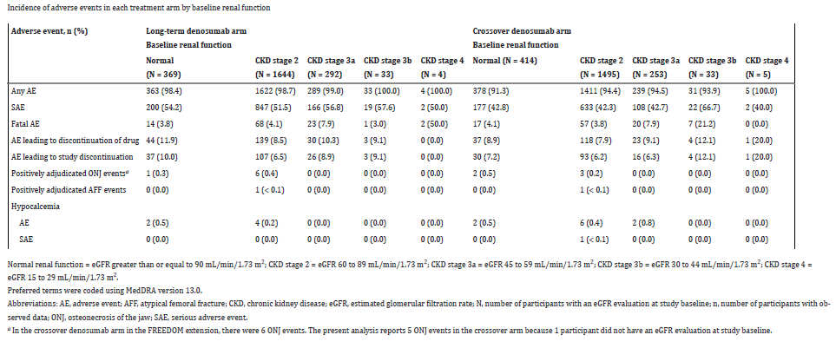
Denosumab Safety and Efficacy Among Participants in the FREEDOM Extension (7 yrs ) Study With Mild to Moderate Chronic Kidney Disease
The safety and efficacy of denosumab did not differ among participants with mild to moderate CKD.
J Clin Endocrinol Metab. 2021 Feb; 106(2): 397–409

Slide 61
Vascular calcification
A 1-year observational study of denosumab in 54 patients on HD found that aortic arch calcification (AoAC) decreased significantly from 25.0 to 20.0% in the denosumab group but increased from 29.4 to 46.25% in the control group (P < 0.01) [1].
The authors speculate that that long-term use of denosumab might have benefits on AoAC in hemodialysis.
In a 1-year RCT of denosumab in HD where calcium was provided alongside drug injection, there was no change in coronary artery calcium score, intima-media thickness at the carotid artery, ankle–brachial pressure index, brachial–ankle pulse wave velocity, or flow-mediated dilation [2].
1. Kidney Int reports 6:605–612. https:// doi. org/ 10. 1016/j. ekir. 2020. 12. 002
2. Iseri K,. J Bone Miner Res 34:. https:// doi. org/ 10. 1002/ JBMR. 3676
Notes:
45. Suzuki S, Suzuki M, Hanafusa N et al (2021) Denosumab recovers aortic arch calcifcation during long-term hemodialysis. Kidney Int reports 6:605–612. https://doi.org/10.1016/j.ekir.2020.12.002
40. Iseri K, Watanabe M, Yoshikawa H, et al (2019) Efects of denosumab and alendronate on bone health and vascular function in hemodialysis patients: a randomized, controlled trial. J Bone Miner Res 34:. https://doi.org/10.1002/JBMR.3676

Slide 62
Studies reporting the risk of hypocalcemia with denosumab in chronic kidney disease populations: Stage 3b–5 CKD were reported to be at highest risk (OR 2.92; 95% CI 1.38–6.20)
Study | Patient | Study duration | Efficacy | Hypocalcemia
Hiramatsu et al., 2021 [38] | 47 HD patients (55.3% female) | 24 months | BMD significantly increased by 5.9 ± 1.7% at LS, 4.2 ± 1.5% at FN | 25.5% developed hypocalcemia defined by a corrected serum calcium of ≤ 8 mg/dL
Kunizawa et al., 2020 [36] | 324 patients 121 HD (60.3% female) and 203 non- HD (85% female) | 5 years | Annual changes LS BMD in HD and non-HD patients increased significantly from baseline (6.7 ± 11.1% and 7.5 ± 10.2%). At the FN, BMD also increased significantly in both groups (4.3 ± 7.9% and 3.1 ± 9.5%) | 35.6% of HD patients experienced hypocalcemia (serum calcium < 8.5 mg/dL). 5.4% of non-HD patients developed hypocalcemia (p < 0.001)
Block et al., 2014 [62] | 32 patients (50% female) 16 stage 4 CKD; 16 stage 5 CKD | 12 weeks | 10/16 (62.5%) stage 5 CKD patients developed hypocalcemia 3/16 (18.8%) stage 4 CKD patients developed hypocalcemia
Kim KJ, Calcif Tissue Int 107:567–575
Hiramatsu R, Nephrol Dial Transplant. https:// doi. org/ 10. 1093/ ndt/ gfaa3 59
Kunizawa K, Sci Rep 10:2496.
Block G, J Clin Oncol 32:e20649–e20649

Slide 63
Risk factor of hypocalcemia with denosumab
Lower pre-treatment albumin-adjusted serum calcium has been predictive of future hypocalcemia (corrected calcium < 9.1 mg/dL [2.27 mmol/L] vs. 9.4 mg/dL [2.35 mmol/L] predicted denosumab-induced hypocalcemia with a sensitivity 77% and specificity 56%) [1].
In a case series of patients with stage 4–5 CKD, low 25-OHD, lack of calcium and calcitriol supplementation, use of non-calcium-based phosphate binders, loop diuretics, previous parathyroidectomy, and acute medical illness were reported as risk factors [2].
A lower baseline ALP and PTH has also been associated with denosumab-induced hypocalcemia defined by a serum calcium < 2.1 mmol/L [3].
1 Tsvetov G (2020) Osteoporos Int 31:655–665
2.Jalleh R, https:// doi. org/ 10. 1155/ 2018/ 73847 63
3. Dave V.Am J Nephrol. https://doi.org/10.1159/000380960
Notes:
52. Tsvetov G (2020) Osteoporos Int 31:655–665
8. Dave VAm J Nephrol. https://doi.org/10.1159/000380960
53.Jalleh R, https:// doi. org/ 10. 1155/ 2018/ 73847 63

Slide 64
Risk factor of hypocalcemia with denosumab
In patients using dialysis, high bone turnover might also increase the risk of denosumab-induced hypocalcemia for reasons described previously.
Hypocalcemia has been particularly described in patients with severe hyperparathyroidism who are administered denosumab [2].
A higher risk of hypocalcemia has also been reported in those with higher levels of tartrate resistant acid phosphatase 5b (a marker of bone turnover) [1, 3].
Other risk factors described in HD populations include use of steroids [1].
1. Kunizawa K, Sci Rep 10:2496.
2. Chen CL, J Clin Endocrinol Metab 99:. https://doi.org/10.1210/ jc.2014-1154
3. Hiramatsu R, Nephrol Dial Transplant. https://doi.org/10.1093/ndt/gfaa359
Notes:
36. Kunizawa K, Sci Rep 10:2496.
37. Chen CL, J Clin Endocrinol Metab 99:. https://doi.org/10.1210/ jc.2014-1154
38. Hiramatsu R, Nephrol Dial Transplant. https://doi.org/10.1093/ndt/gfaa359

Slide 65
Approach to mitigating hypocalcemia in advanced CKD
Carefully selected
Supplemented with calcium and vitamin D if deficient
Receive calcium and vitamin D prophylaxis during denosumab treatment, and are
Closely monitored.
A PTH of 2–9 × the upper limit of normal, for example, is suggested in HD to minimize the risk of both adynamic bone disease and severe hyperparathyroidism 18
Prior to treatment with denosumab, assessment of bs-ALP can also be helpful and in fact might have more diagnostic accuracy for both high and low-turnover bone disease, particularly if combined with PTH [54, 55].
54. Sardiwal S, Am J Kidney Dis 62:810–822.
55. Urena P, J Am Soc Nephrol 7:506–512
18. Ketteler M, Kidney Int 92:26–36. https://doi.org/10.1016/j. kint.2017.04.006

Slide 66
Calcium and vitamin D supplementation/ prophylaxis
In those with advanced CKD, oral calcium (3 g/day) can be administered and may need to be given between meals, not just with meals for phosphate-binding [1].
There may also be a role for prophylactic activated vitamin D (e.g., calcidiol 0.5 to 2 ug/day) [1].
In HD patients, adjustment of dialysate calcium (up to 3.5 meq/L) has been suggested [1].
1. Chen CL,. J Clin Endocrinol Metab 99:. https://doi.org/10.1210/ jc.2014-1154
Notes:
37. Chen CL,. J Clin Endocrinol Metab 99:. https://doi.org/10.1210/ jc.2014-1154

Slide 67
Close monitoring
Given the half-life of denosumab is 25–30 days, monitoring for hypocalcemia needs to be at least this long [1 )
In published studies, hypocalcemia tends to occur within the 7–20 days following the first dose
1. Kunizawa K, Sci Rep 10:2496. https://doi.org/10.1038/s41598-020-59143-8

Slide 68
Summary

Slide 69
Osteoblast formation stimulated by osteoprotegerin (OPG)
Osteoclast differentiation is mediated by RANKL
Sclerostin reduces osteoblastogenesis promotes osteoblast
Fragility fracture incidence is proportional to decrease in eGFR (4.3%- 9.6%)
Hip fracture in CKD / Dialysis reported to have 2- fold higher mortality
Incidence of post transplant fracture is as high as 40%
Glucocorticoid withdrawal was associated with a 31 % reduction in fracture risk

Slide 70
Glucocorticoid withdrawal was associated with a 31 % reduction in fracture risk
KDIGO suggest that given this new evidence, BMD could be performed, particularly if it might impact the decision to perform a bone biopsy
CKD stage 1–3 disease
Recommend measuring baseline serum calcium, phosphate, PTH, alkaline phosphatase (ALP), and 25 hydroxyvitamin D (25-OHD) as a start
If values are normal , antiresorptive medications as per usual osteoporosis guidelines
In patients in the first 12 months after kidney transplant with an estimated glomerular filtration rate greater than approximately 30 ml/min/ 1.73 m2 and low BMD, we suggest that treatment with vitamin D, calcitriol/alfacalcidol, and/or antiresorptive agents be considered

Slide 71
Denosumab
RANKL antibody
No need to adjust dose in CKD
Hypocalcemia and bone pain
Zoledronic acid
Causes nephrotoxicity
Not recommended in severe renal impairment
Romosozumab
Anti-human sclerostin
Black box warning :May increase risk of MI, stroke, and cardiovascular death.
Teriparatide
Black box warning : Risk of osteosarcoma
CKD : Meta analysis of 17 studies with 10214 patients , reduced fracture risk by Teriparatide (-81%), Denosumab (- 60%), Alendronate (-39%) and Raloxifene (-33%) (Front Pharmacol. 2022 Feb 11;13:822178)
Hemodialysis patients with osteoporosis BMD was increased at 6 months in denosumab-treated patients compared with patients not treated with denosumab

Slide 72
Denosumab as compared to bisphosphonate , associated with increased BMD and alleviated progression of joint destruction in RA patients
Hypocalcemia and risk factor
Stage 3b–5 CKD (OR 2.92; 95% CI 1.38–6.20)
Stage 4–5 CKD, low 25-OHD, lack of calcium and calcitriol supplementation, use of non-calcium-based phosphate binders, loop diuretics, previous parathyroidectomy, and acute medical illness
A lower baseline ALP and PTH
Severe hyperparathyroidism
Calcium and vitamin D prophylaxis
Monitor hypocalcemia post denosumab dose for at least 25-30 days
Withdrawal of denosumab therapy may be associated with an increased risk of vertebral fracture

Slide 73
Antiresorptive Therapy
Algorithm

Slide 74
CKD
CKD stage 1–3 disease
CKD stage 4-5 disease
Kidney transplant bone disease
CKD G1–G2 with osteoporosis and/or high risk of fracture*
CKD G3a–G3b with PTH in the normal range and osteoporosis and/or high risk of fracture*
First 12 months
After12 months
As defined by the World Health Organization (WHO), osteoporosis is present when BMD is 2.5 SD or more below the average value (a T-score of <−2.5 SD).
eGFR > 30 ml/min/ 1.73 m2 and low BMD, treatment with vitamin D, calcitriol/alfacalcidol, and/or antiresorptive agents be considered
Insufficient data to guide on treatment after 12 months
Baseline serum calcium, phosphate, PTH, alkaline phosphatase (ALP), and 25 hydroxyvitamin D (25-OHD)
Normal
Antiresorptive medications as per usual osteoporosis guidelines
*Risk factors by 2020 AACE
Prior fracture without major trauma (other than fingers, toes, skull) after age 50 years | Clinical risk factors for osteoporosis Age ≥65 years Low body weight Smoking Early menopause Excessive alcohol intake | Prior spine fractures Glucocorticoid therapy equivalent to ≥5 mg of prednisone per day for 3months or more Secondary osteoporosis Height loss of kyphosis Risk factors for falling With radiographic osteopenia
Lifestyle modification • Nutrition • Vitamin D • Weight-bearing physical activity • Fall prevention • Cessation of smoking
Follow-up • Assess for compliance and side effects • BTMs to verify compliance • Beware of discontinuing denosumab

Slide 75
CKD
CKD stage 4-5 disease
High
Country-specific FRAX fracture possibility
DXA-based BMD at spine or hip: T ≤ –2.5
Fragility fractures (spine, hip, proximal humerus, pelvis or multiple)
Postmenopausal , Age > 50 years
Lateral imaging of spine
Vertebral fracture assessment
Bone biopsy
Suggested particularly in those with CKD stage 3a–5D
2017 update to the KDIGO guidelines emphasize that antiresorptive therapy should not be withheld for bone biopsy
KDIGO suggests, that if baseline serum calcium, phosphate, PTH, and 25-OHD are abnormal, the following might be considered
CKD–MBD and metabolic control
Hyperphosphatemia
Reduce dietary phosphate
If resistant, phosphate binders can be considered
In CKD stage 5, dialytic removal of phosphate can be used
Hypocalcemia
Serum calcium should be maintained within the reference range,
Vitamin D
Hyperparathyroidism
If PTH remains out of target despite correction of hypocalcemia, hyperphosphatemia, and use of vitamin D analogs, calcimimetics followed by parathyroidectomy might be considered
Rule out adynamic bone disease
Hemodialysis (HD) patients (in whom adynamic bone disease is particularly prevalent), bs- ALP < 20 μg/L (0.02 U/L) and PTH < 200 ng/L (21 pmol/L) had 100% sensitivity, 100% specificity, 100% PPV, and 84% NPV for adynamic bone disease
The use of antiresorptive medications in adynamic bone disease might worsen bone health
Antiresorptive medications as per usual osteoporosis guidelines

Slide 76
Antiresorptive medications as per usual osteoporosis guidelines
Lifestyle modification • Nutrition • Vitamin D • Weight-bearing physical activity • Fall prevention • Cessation of smoking
Follow-up • Assess for compliance and side effects • BTMs to verify compliance • Beware of discontinuing denosumab
Denosumab
Clinical use Denosumab in osteoporosis/ osteopenia associated with Kidney Transplant Patients
Denosumab in osteoporosis/ osteopenia associated with CKD
Onset
Studies in postmenopausal women with osteoporosis indicate reduction in bone resorption biomarkers observed within 3 days after a 60-mg dose; maximal reductions observed by 1 month
Dosage
60 mg once in 6 months subcutaneous + Calcium 1000 mg + at least 400 IU vitamin D daily through the duration of therapy
Reversal of effect
Bone mineral density (BMD) and levels of bone resorption markers return to baseline within 12 months after discontinuing denosumab.
Common adverse effect
Back pain, extremity pain, musculoskeletal pain, hypercholesterolemia, cystitis (postmenopausal women) or back pain, arthralgia, nasopharyngitis (men)
Precaution
Correct preexisting hypocalcemia prior to initiating denosumab.
severe renal impairment (Clcr <30 mL/minute) or receiving dialysis are at greater risk of developing hypocalcemia
Pregnancy and lactation : not recommended
Pediatric : not recommended < 4 years
Renal impairment : no dose adjustment
Hepatic Impairment: no dose adjustment
Contraindication
Hypocalcemia, Pregnancy, Hypersensitivity
Duration of therapy
FREEDOM 7 years Extension trial reported safety and efficacy of Denosumab
Monitoring
Clinical monitoring of calcium and mineral levels (phosphorus and magnesium) is highly recommended within 14 days of injection.
Hypocalcemia persisted for weeks or months and required frequent monitoring and intravenous and/or oral calcium replacement, with or without vitamin D

